Slide 1
Chapter 5
Database Processing

Slide 2
“We Don’t Have a Way to Track the Data About the Videos.”
Falcon Security stores sequentially numbered digital video files in separated directories for each client
Tracking down exact footage of when equipment stolen is time consuming
Need database to track specific video files
MongoDB for tracking video files?
Notes:
GOALS
Illustrate the need for video database.
Set up the need for NoSQL databases like those processed by MongoDB
Go to the MongoDB for video storage to learn about its capabilities.

Slide 3
Study Questions
Q1: Why do you need to know about databases?
Q2: What is a database?
Q3: What is a database management system (DBMS)?
Q4: How do database applications make databases more useful?
Q5: How can falcon security benefit from a database system?
Q6: What are nontraditional DBMS products?
How does the knowledge in this chapter help you?
Notes:
This chapter addresses the why, what, and how of database processing. It begins by describing the purpose of a database and then explain the important components of database systems.
Next, it discuss data modeling and show how IS professionals use data models to design database structure.
It discusses how a database system could be used to solve the tracking problem at Falcon Security.
It wraps up with discussion of new database technology.

Slide 4
Q1: Why Do You Need to Know About Databases?
Can database technology facilitate your project goals?
Databases are ubiquitous in commerce.
How to turn data into useful information.
Business adaptation requires changing database structure.
As future business professional, you might need to build a database.

Slide 5
What Is the Purpose of a Database?
Organize and keep track of things
Keep track of multiple themes
General rule:
Single theme – use a spreadsheet
Multiple themes - use a database
What's a theme?
Ex: student grades, student emails, student office visits.
Notes:
General rule:
Use a spreadsheet for lists of data involving single theme.
Use a database for data with multiple themes.

Slide 6
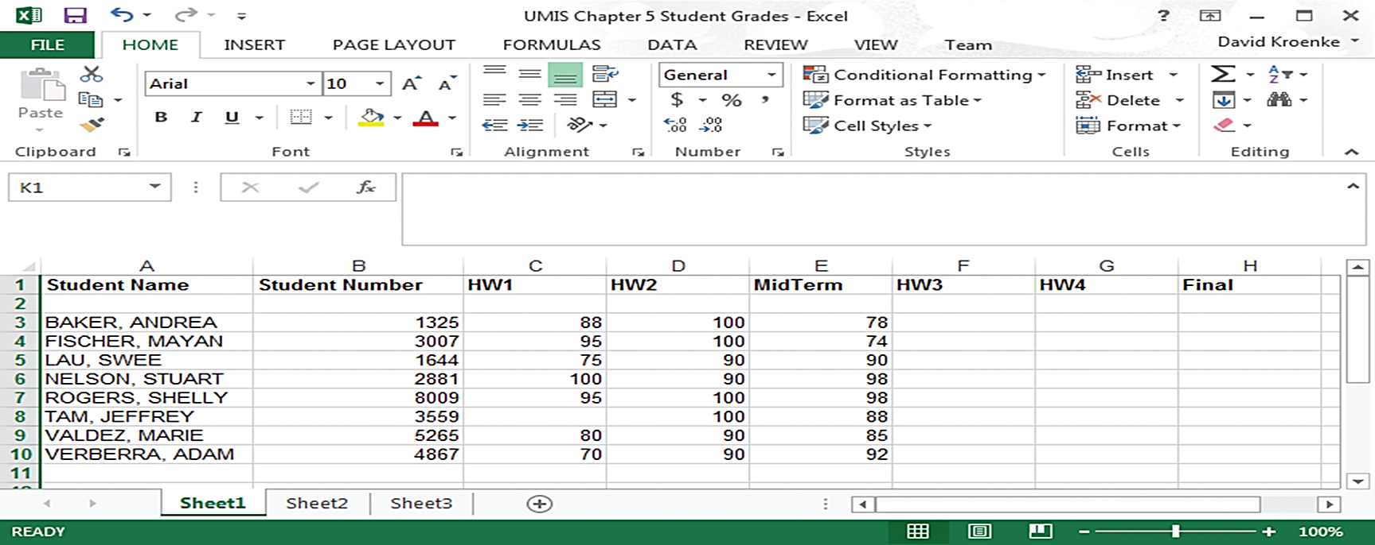
A List of Student Grades Presented in a Spreadsheet – Single Theme
Notes:
Key distinction between in this figure and next slide, Student Grades is the only them. Email and Office Visit data is not included.

Slide 7
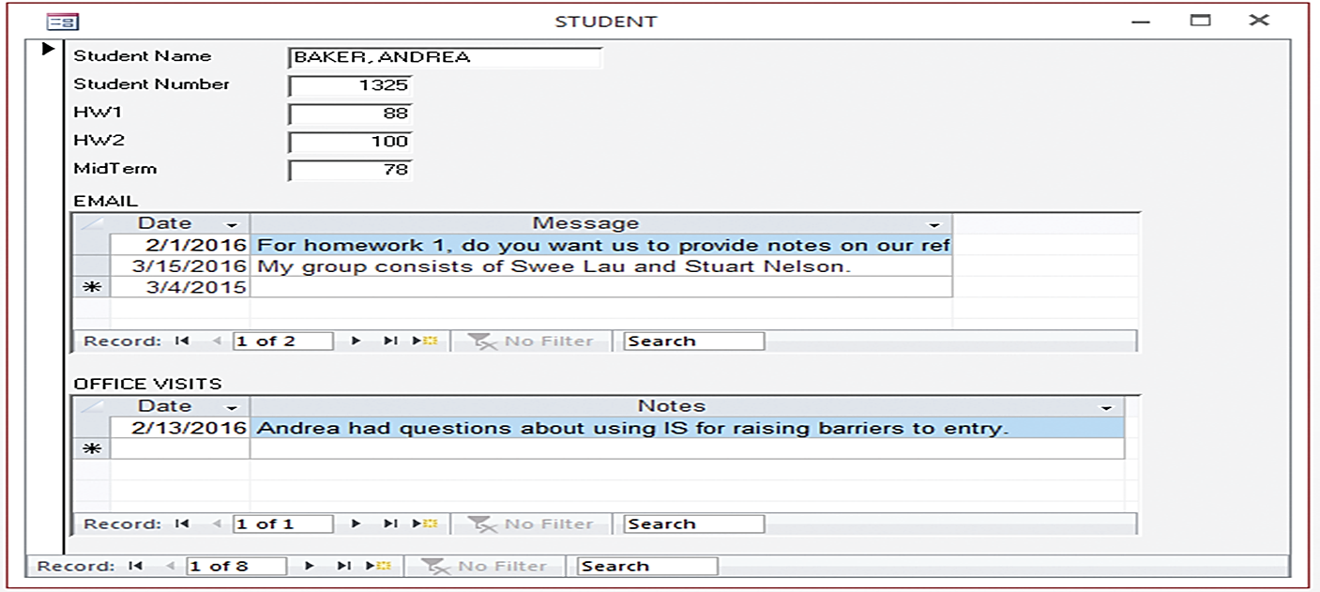
Student Data Form for a Database Application
Notes:
Forms are difficult, if not impossible, to produce with a spreadsheet, but are easily produced with a database.

Slide 8
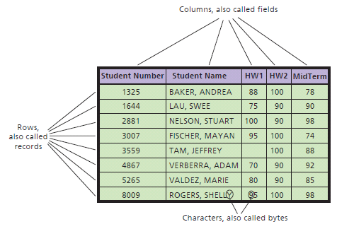
Q2: What Is a Database?
Notes:
Relationships of rows and columns in a database.
Database - self-describing collection of integrated records.

Slide 9
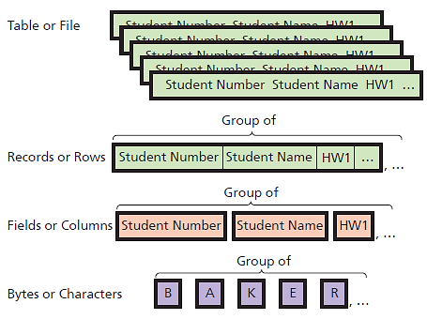
Hierarchy of Data Elements
Notes:
Database is a collection of related tables.

Slide 10
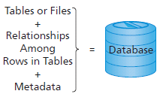
Components of a Database
Notes:
Formal term for table is “relation”. Linking relations together creates relationships. A database is a group of related tables. Metadata describes definitions of tables, fields and relationships.

Slide 11
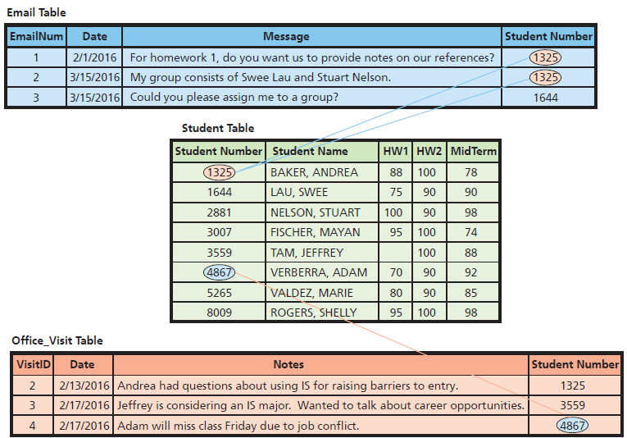
Example of Relationships Among Rows
Notes:
Foreign keys of top and bottom tables related to primary keys of Student Table.

Slide 12
Q3: What Is a Database Management System (DBMS)?
Functions of a DBMS
Creating the Database and its structures
Processing the database
Administering the database
Licensed from vendors
IBM, Microsoft, Oracle, and others
Open source
MySQL: License-free for most applications

Slide 13
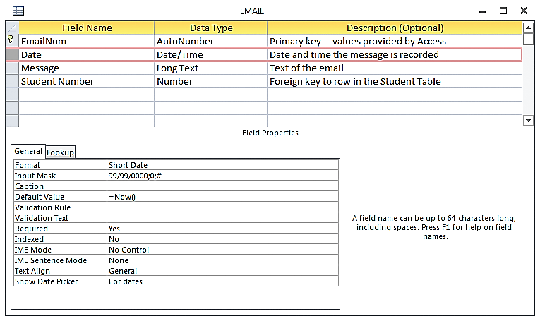
Creating the Database and its structures: Metadata
Notes:
Access example of metadata describing the structure for the Email table. Metadata makes a database self-describing.

Slide 14
Processing the Database
DBMS Process Operations
Read
Insert
Modify
Delete data
Notes:
These operations are requested in applications that call upon DBMS in different ways.

Slide 15
Processing the Database with SQL
Structured Query Language - SQL (see-quell)
International standard
Used by nearly all DBMS
SQL Example
INSERT INTO Student
([Student Number], [Student Name], HW1, HW2, MidTerm)
VALUES (1000, ‘Franklin, Benjamin’, 90, 95, 100)
Notes:
Structured Query Language (SQL) used for processing the database. SQL - international standard language for creating databases and database structures, and processing databases. Used by all popular DBMS products.

Slide 16
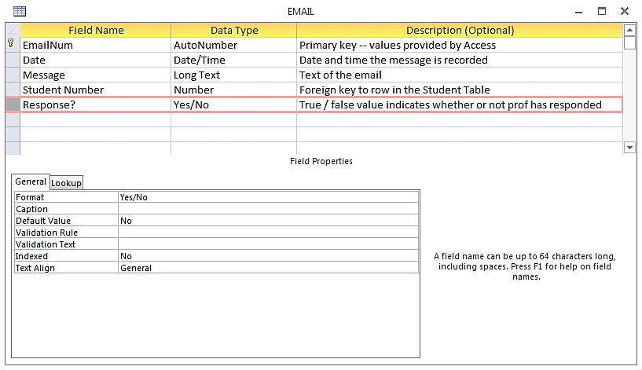
Adding a New Column to a Table (in Access)
Notes:
No SQL knowledge needed to add column to table.

Slide 17
Administering the Database
Set up security system, user accounts, passwords, permissions, limits for processing
Limit user permissions
Back up database, improve performance of database applications, remove unwanted data
Notes:
Third DBMS function is to provide tools to assist in the database administrator in performing these tasks.

Slide 18
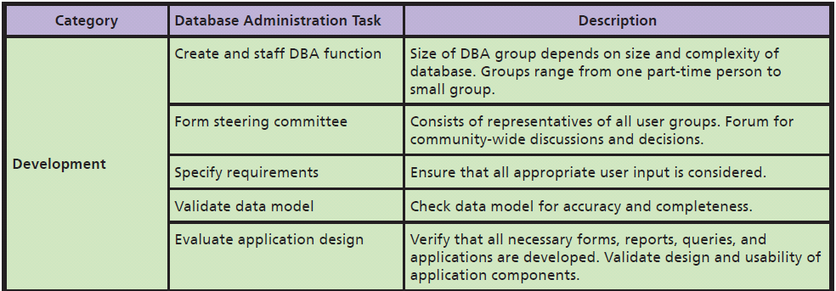
Summary of Database Administration Tasks

Slide 19
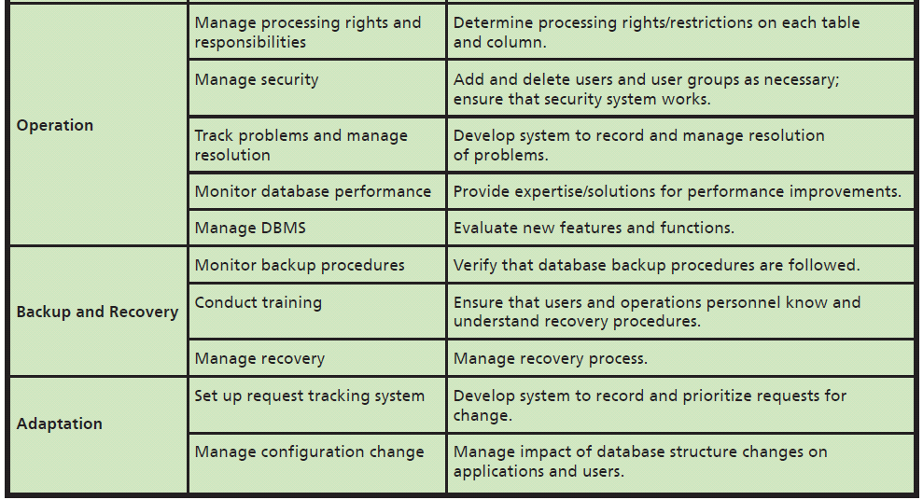
Summary of Database Administration Tasks (cont'd)
Notes:
DBMS provides tools to assist in database administration. Database administration involves a wide variety of activities.
Permissions can be limited in very specific ways.

Slide 20
Q4: How Do Database Applications Make Databases More Useful?
Forms | View data; insert new, update existing, delete existing data.
Queries | Search based upon data values provided by user.
Reports | Structured presentation of data using sorting, grouping, filtering, other operations.
Application programs | Provide security, data consistency, special purpose processing, e.g., handle out-of-stock situations.
Notes:
Four elements of database applications and purpose of each.

Slide 21
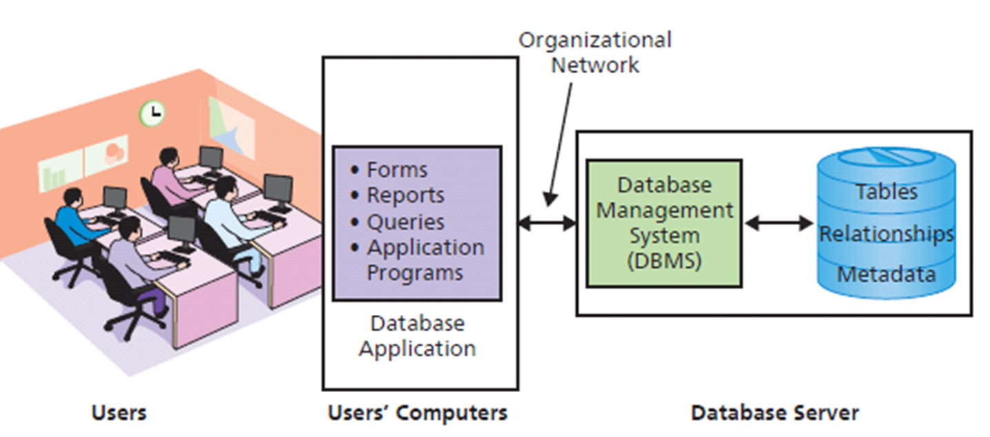
Q4: How Do Database Applications Make Databases More Useful? (cont'd)
Notes:
Components of a Database Application System.
The DBMS acts as an interface between user applications and the actual database.

Slide 22
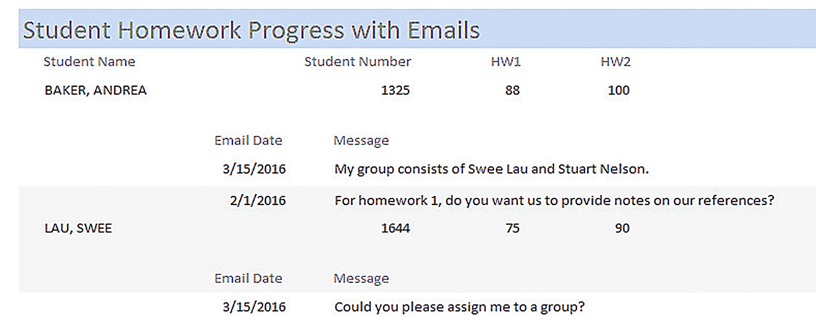
Example of a Student Report

Slide 23
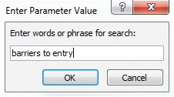
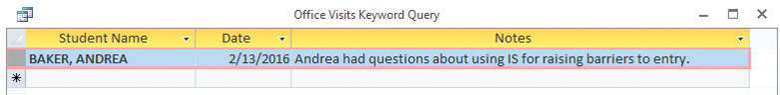
Query Example
Notes:
Typical database application report, query form and query report. Structure of this report creates information because it shows student data in a context meaningful to the professor.
DBMS programs provide comprehensive and robust features for querying database data.

Slide 24
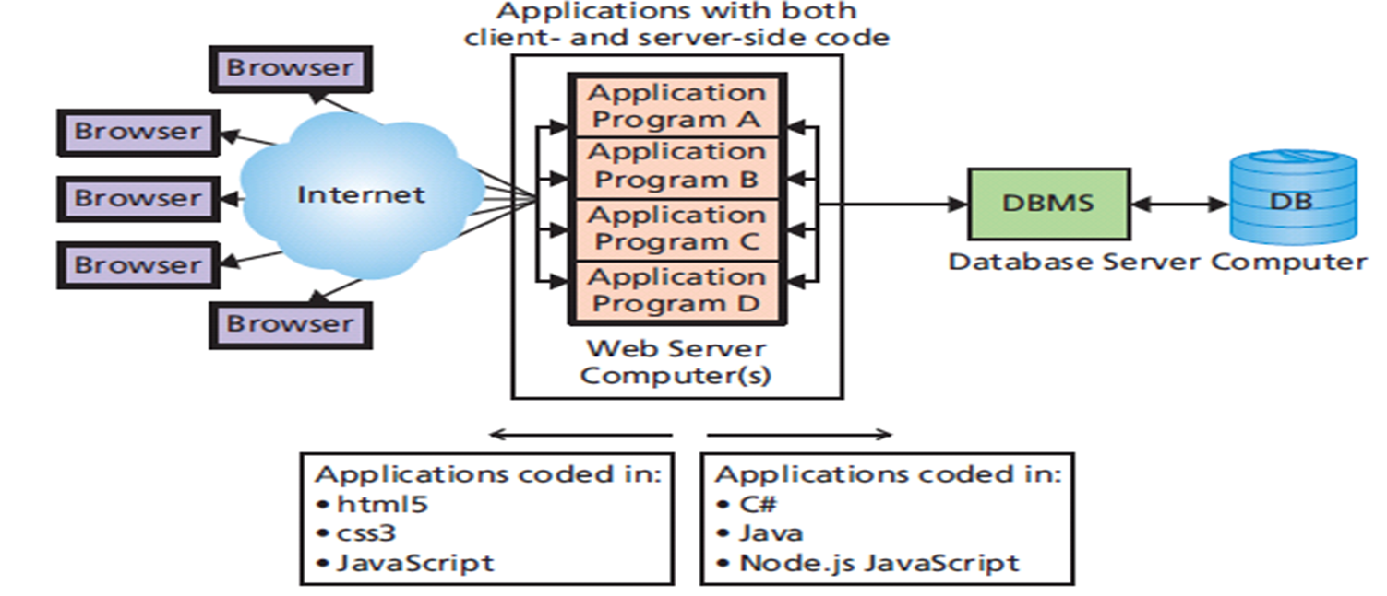
Browser Forms, Reports, Queries, and Applications
Notes:
Traditional database applications programs, written in object-oriented languages such as C++ and VisualBasic, and even COBOL, are thick applications.
In some cases, all application logic is contained program on users’ computers and server does nothing except run the DBMS and serve up data.
In others, some application code is placed on both users’ computers and database server computer.

Slide 25
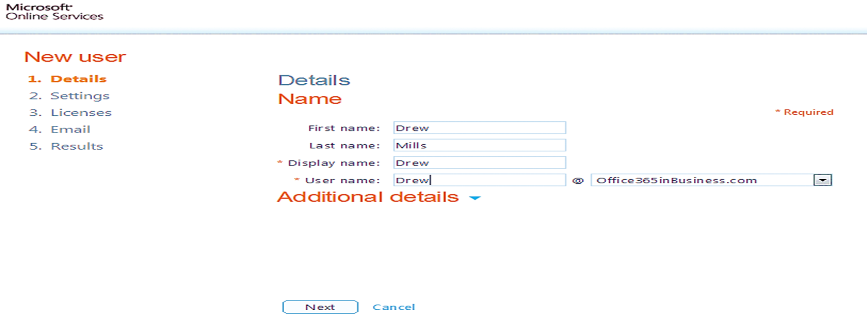
Account Creation Browser Form

Slide 26
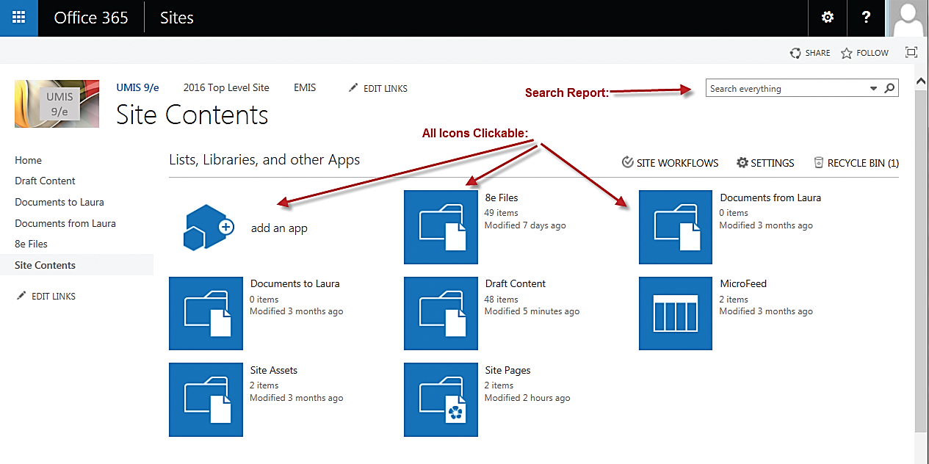
Browser Report for SharePoint Site
Notes:
The content is dynamic; almost all of the items can be clicked to produce other reports or take other actions. The user can search in the box in the upper-right-hand corner to find specific items.

Slide 27
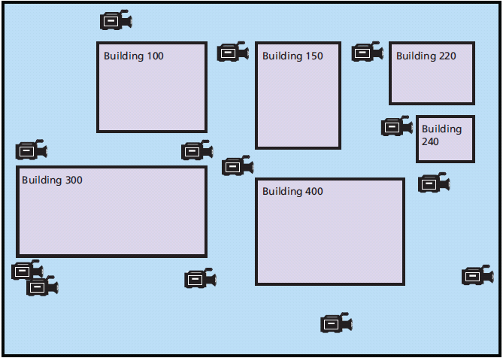
Graphical Query: User Clicks on Video Icon to Find All Videos from That Location
Notes:
Browser-based applications can support traditional queries, but more exciting are graphical queries in which query criteria are created when the user clicks on a graphic.
The user can click on any one of the video icons on the map, and that click will initiate a query to return a list of all the videos available from that location.

Slide 28
Multiuser Processing Lost-update Problem
Andrea puts both in shopping baskets, but delays checking out.
Andrea reads pedal record showing balance of 2 pedals.
Andrea proceeds to checkout. Someone will be disappointed.
1
2
3
4
5
Jeffrey reads same record showing balance of 2 pedals.
Jeffrey puts both in shopping basket and checks out before Andrea.
Notes:
At a ticket vendor’s Web site, two customers, Andrea and Jeffrey, are both attempting to buy the last two tickets to a popular event.
Lost-update problem is one of the special characteristics of multi-user database processing. To prevent this problem, some type of locking must be used to coordinate the record update activities of multiple users. Locking has own set of problems and those problems must be addressed as well.
Realize converting a single-user database to a multiuser database requires more than simply connecting another computer. The logic of the underlying application processing needs to be adjusted also. If you find inaccurate results, you may be experiencing multiuser data conflicts. Contact your IS department for assistance.

Slide 29
Q7: How Can Falcon Security Benefit from a Database System?
Find videos by querying their characteristics
“Which videos do we have of the Beresford Building in October 2014, shot from 3,000 feet or less?”
Choices
Store videos on a file server and keep metadata about each video in a relational database to query with SQL
Use NoSQL MongoDB

Slide 30
Falcon Security Chooses Option 1
Use Access to store metadata
Less risky: uses known technology
Creates E-R diagram. (Fig. 5-28)
Decides to keep design simple at first
Notes:
Toshio and Cam decide to use Access to store the metadata. They know this approach is less risky because it uses known technology. Also, both of them are skilled at using Access, and they can develop the database and application quickly with less risk.

Slide 31
Q5: What Are Nontraditional DBMS Products?
Relational model is not needed today
Need to store new data types differently
Atomic, Consistent, Isolated, Durable transactions
Critical to traditional commercial applications
New Internet applications (Twitter) don’t need ACID
Notes:
Limitations were removed by improved storage and processing technology, and today they do not exist.
Either all of a transaction is processed or none of it is (atomic). Transactions are processed in the same manner (consistent) whether processed alone or in the presence of millions of other transactions (isolated). Once a transaction is stored it never goes away—even in the presence of failure (durable).
ACID transactions are critical to traditional commercial applications. Even in the presence of machine failure,

Slide 32
Need for Faster Processing Using Many Servers
Dynamo
Developed a nonrelational data store
Bigtable
Google developed a nonrelational data store called
Cassandra
Facebook took concepts from both of systems
Top-Level Project (TLP)
Open-source Cassandra by Apache
Notes:
The purpose of non-relational databases is the need to gain faster performance using many servers.

Slide 33
Three Categories of Nontraditional DBMS
NoSQL DBMS (NonRelational DBMS)
Supports very high transaction rates processing relatively simple data structures
Replicated on many servers in the cloud, without ACID transaction support
MongoDB, Cassandra, Bigtable, and Dynamo

Slide 34
Nontraditional DBMS Types (cont’d)
NewSQL DBMS
Process very high levels of transactions, like the NoSQL DBMS, but provide ACID support
May or may not support relational model
Current hotbed of development
In-memory DBMS
SAP HANA, Tableau
High volume ACID transaction support with complex relational query processing
Notes:
SAP HANA is a computer with an in-memory DBMS that provides high-volume ACID transaction support simultaneously with complex relational query processing.
Tableau Software’s reporting products are supported by a proprietary in-memory DBMS using an extension to SQL.

Slide 35
Will These New Products Replace the Relational Model?
Probably not.
Conversion enormously expensive and disruptive
NoSQL DBMS products very technical and require a deep background in computer science to use
NoSQL’s impact on DBMS product market?
Database software market experience viable new entrants

Slide 36
What Do Nonrelational DBMS Mean for You?
What do non-relational DBMS mean for you?
Knowledge is useful--stay abreast of developments
Watch nonrelational DBMS product developments from an investor’s perspective
New opportunities and career paths will develop around nonrelational databases
Use knowledge to separate yourself from competition when it comes to job interviews

Slide 37
How Does the Knowledge in this Chapter Help You?
Understand purpose of a database and ways databases processed
Know about new categories of nontraditional DBMS
This knowledge will enable you to be an effective team member when your organization has needs like those at Falcon Security

Slide 38
Ethics Guide: Querying Inequality?
MaryAnn has a data mart
Business professional majored in HR, now "expert" in SQL
Uses SQL to do job faster and better
Examined the data, saw possible discriminatory pattern
What would you do from categorical imperative and utilitarian perspectives?
Notes:
GOALS
Illustrate the utility of queries and SQL.
Set up a realistic situation that raises important social responsibility issues. Ask students what they think that term means .
Show a non-IS major—an HR major in fact—doing SQL queries…and show this situation is realistic.

Slide 39
Ethics Guide: Querying Inequality? (cont’d)
Queries could reveal all sorts of patterns and trends
Be sure what answers you want before starting query
How strongly do you feel about social and personal responsibility, considering your needs and those of your family?
How important is social responsibility posture of an employer to you?
Is that something to add to your criteria for finding a job?
Notes:
This guide introduces the concept of social responsibility, a term not discussed per se in the guide.
Patterns and trends could be known or unknown to company managers, intended or spurious correlations.
Have class consider risks in informing management of what you find.

Slide 40
Security Guide: Theft by SQL Injection
One common way of stealing data from corporations
Done by people outside of host nation to avoid prosecution
Highly organized and well-funded
Criminal syndicates, nation states, or political hacktivists
Mandiant report “APT1: Exposing One of China’s Cyber Espionage Units”
Attempting SQL injection could result in your arrest
Notes:
GOALS
Understand one user’s experience in the development of a database application.
Explore security requirements for a shared database.
Understand one way that users respond to technology challenges.

Slide 41
Injection happens when unexpected text entered into that Web form that changes the way the SQL statement is processed
SELECT * FROM Users WHERE username=’JohnDoe001’ AND password=’password1234’;

Slide 42
Security Guide: Theft by SQL Injection (cont'd)
SELECT * FROM Users WHERE username=’JohnDoe001’
AND password=’anything’ or 1=1 --’;
“anything” will not match the correct password in the database
“or 1=1 --’ was included the resulting comparison (1=1) will always be “true.”
=1 is true, and only one side of comparison needs to be true to bypass login screen and gain access to the system
Notes:
Similar malformed SQL statements can be used to extract, add, or delete data. There is even software available that largely automates the SQL injection process.

Slide 43
Active Review
Q1: Why do you need to know about databases?
Q2: What is a Database?
Q3: What is a Database Management System (DBMS)?
Q4: How do database applications make databases more useful?
Q5: How can falcon security benefit from a database system?
Q6: What are nontraditional DBMS products?
How does the knowledge in this chapter help you?
Notes:
This chapter addresses the why, what, and how of database processing. It begins by describing the purpose of a database and then explain the important components of database systems.
Next, it discuss data modeling and show how IS professionals use data models to design database structure.
It discusses how a database system could be used to solve the tracking problem at Falcon Security.
It wraps up with discussion of new database technology.

Slide 44

Case Study 5: Shane's Car Parts Database
Highly qualified classic and vintage car mechanic – 20 years experience
Served apprenticeships with luxury marques Jaguar and Bentley
Notes:
Goal
Illustrate complexity of Amazon’s Dynamo database server system, Google’s Bigtable and Facebook’s Cassandra.
Stress the competitive importance of a company’s database system.
Illustrate Moore’s Law at work.

Slide 45


Car Parts in Storage

Slide 46
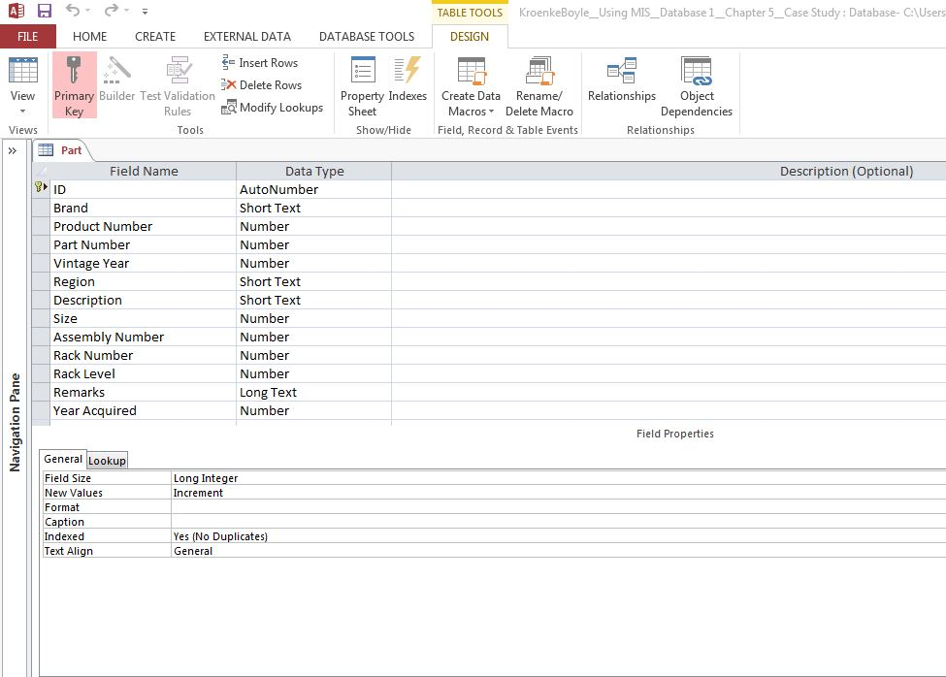
Columns in the Car Part Table (contd.)
Notes:
Dean created a Microsoft Access database with only one table: Piano.
Used Access because he wants to query his data in a variety of ways.
Because of the dynamic nature of his needs, Dean uses the Access query facility.

Slide 47
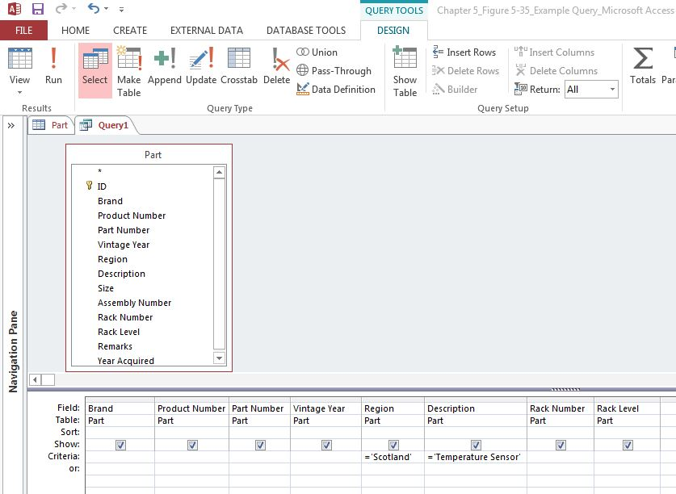
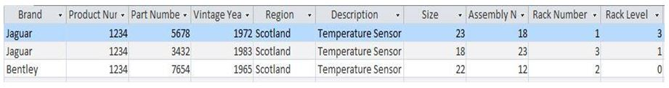
Query Design and Result

